Slide 1
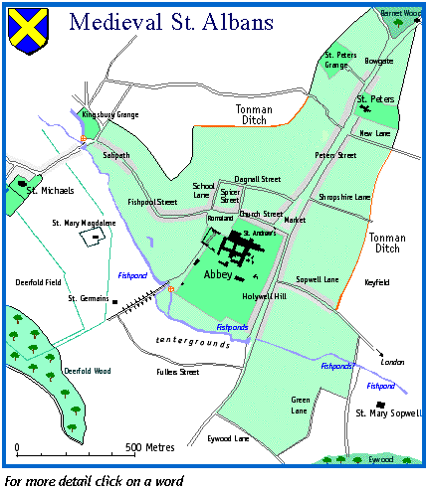
St Albans and the Great Revolt of 1381
15 June 1381: The rebels hold a meeting with representatives from surrounding villages in Luton, Watford, Barnet, Rickmansworth, Tring and Redbourn, swearing an oath of loyalty to each other and demanding their rights of freedom from the Abbey’s control.
Late June/early July 1381: A local jury refuses to convict Grindecobbe and the other rebel leaders, and they are released on bail after the local townspeople raise £300. They refuse to hand over the charters of freedom.
6 July 1381: Grindecobbe and other local leaders are again imprisoned and put on trial by Chief Justice Tresilian. Tresilian uses threats against the townspeople in order to secure guilty verdicts.
17–29 June 1381: There is an uneasy truce between the townspeople and the Abbey in St Albans, but throughout the Revolt no one is killed or injured except for the executed prisoner John Baron.
15 July 1381: Richard II oversees the execution of Grindecobbe and 15 other rebel leaders, including the radical priest John Ball (who had been captured in Coventry and brought to trial in St Albans). The rebels are forced to give up their charters of freedom and swear loyalty to the King.
Richard Wallingford, Thomas Peyntor and 80 other St Albans rebels are convicted and sent to prison. However, they are later released and pardoned by the King.
15 June 1381: The millstones that had been confiscated by a previous St Albans abbot are dug up and returned to the families from whom they had been taken. The Abbey's prison is smashed open and all the prisoners released, except John Baron, who is found guilty of his crimes by the rebels and executed.
August 1381: Large numbers of villagers in the Abbey's manors of Watford and Rickmansworth run away, resulting in the harvest not being collected. This leads to a loss of a large amount of money for the Abbey.
16 June 1381: Abbott de la Mare is forced to give further concessions to the rebels in St Albans and surrounding villages, giving access to common lands and ending feudal services.
12 June 1381: Townspeople present their demands to Thomas de la Mare, Abbot of St Albans Abbey, for the town to be free of the Abbey’s control.
29 June 1381: Sir Walter atte Lee, a local knight and MP, rides into St Albans with 50 men-at-arms and a large number of archers. He demands that the town surrenders its charters of freedom and arrests Grindecobbe and other rebel leaders, imprisoning them in Hertford Castle.
After the execution of Grindecobbe and the other rebels, the St Albans townspeople are forced to hand over their charters of freedom and pay compensation to the Abbey.
14 June 1381: In the early hours of the morning, messengers arrive in St Albans asking for support for the Revolt. William Grindecobbe and a group of townspeople head to London. Some monks flee the Abbey in fear of their lives. The Abbot remains and sends monks to London to report on events.
15 June 1381: Richard Wallingford returns from Mile End with a royal charter granting the townspeople of St Albans their freedom. The Abbot is forced to hand over legal documents, which are burned in the town square, but refuses to hand over the ancient charter of King Offa that had granted St Albans its freedom from control by the Abbey.
14 June 1381: William Grindecobbe and a group of St Albans rebels on the way to London witness Jack Straw and Essex rebels, supported by Londoners, burn down Sir Robert Hale’s manor house at Highbury, North London.
15 June 1381: Later the same day, and following the death of Tyler and dispersal of rebels in London, Richard II issues letters granting protection to St Albans, which prohibit any ‘grievance, damage or molestation’ against the rebels.
15 June 1381: Returning back from Smithfield late the night before, Grindecobbe and the St Albans rebels tear down hedges and fences with which monks had enclosed fields, displaying rabbits on their spears as a symbolic gesture.
14 June 1381: William Grindecobbe and his group are present at the Mile End meeting, departing soon afterwards, leaving Richard Wallingford to obtain charters of freedom for the townspeople.
Notes:
Image: www.salbani.co.uk/Med%20Web/medtown.htm

Slide 2
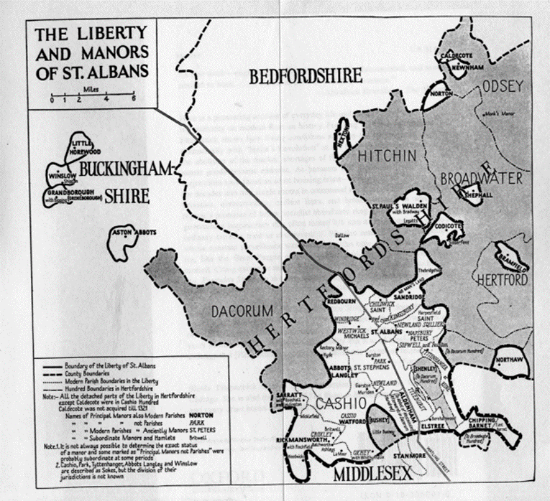
May 1381: There are widespread rumours and reports of opposition and resistance to the collection of the third poll tax by royal officials.
2 June 1381: There is an armed attack by local people near Brentwood, Essex on the royal official Robert Bealknap and his poll tax commission.
5–10 June 1381: There is widespread revolt in Kent, led by Wat Tyler, and Essex, led by Jack Straw, against the poll tax, targeting royal officials, wealthy churchmen and official records of land ownership and debts.
7 June 1381: Poll tax rebels enter and seize control of Maidstone, Kent, led by Wat Tyler. Radical preacher John Ball is released from prison by the rebels.
11–12 June 1381: Kent and Essex assemble at Blackheath and Mile End, just outside the City of London.
16 June 1381: Abbott de la Mare is forced to give further concessions to the rebels in St Albans and surrounding villages, giving access to common lands and ending feudal services.
15 June 1381: Later the same day, and following the death of Tyler and dispersal of rebels in London, Richard II issues letters granting protection to St Albans, which prohibit any ‘grievance, damage or molestation’ against the rebels.
15 June 1381: The millstones that had been confiscated by a previous St Albans abbot are dug up and returned to the families from whom they had been taken. The Abbey's prison is smashed open and all the prisoners released, except John Baron, who is found guilty of his crimes by the rebels and executed.
15 June 1381: Returning back from Smithfield late the night before, Grindecobbe and the St Albans rebels tear down hedges and fences with which which monks had enclosed fields, drain the Abbot’s fish pond and divide Abbey land between themselves.
15 June 1381: Richard Wallingford returns from Mile End with a royal charter granting the townspeople of St Albans their freedom. The Abbot is forced to hand over legal documents, which are burned in the town square, but refuses to hand over the ancient charter of King Offa that had granted St Albans its freedom from control by the Abbey.
12 June 1381: Townspeople present their demands to Thomas de la Mare, Abbot of St.Albans Abbey, for the town to be free of the Abbey’s control.
14 June 1381: In the early hours of the morning, messengers arrive in St Albans asking for support for the Revolt. William Grindecobbe and a group of townspeople head to London. The Abbot also sends monks to London to report on events.
15 June 1381: The rebels hold a meeting with representatives from surrounding villages in Luton, Watford, Barnet, Rickmansworth, Tring and Redbourn, swearing an oath of loyalty to each other and demanding their rights of freedom from the Abbey’s control.
15 June 1381: Richard II meets the rebels again, this time at Smithfield, just outside the city walls. In a moment of confusion at the Smithfield meeting, Wat Tyler is killed by William Walworth, the Lord Mayor of London. Richard II appears to agree to the rebels' demands and persuades the rebels to return home.
14 June 1381: In the morning, Richard II meets rebels at Mile End and appears to agree to the rebels' demands. Later in the afternoon, rebels are able to enter the unguarded Tower of London and drag out and publicly execute Sudbury, Hales and other royal officials.
15 June 1381: Following the Smithfield meeting, King Richard II and his supporters quickly restore his authority in London. Jack Straw and other rebel leaders are caught and executed.
13 June 1381: After an unsuccessful meeting with King Richard II at Rotherhithe, Kent rebels, led by Tyler, enter London via London Bridge.
Notes:
Image copyright unknown. Every effort has been made to trace all image copyright holders and permissions in these resources, although occasionally it has not been possible to identify them. Please contact Maheema Chanrai at maheema.chanrai@history.org.uk with any queries.

Slide 3
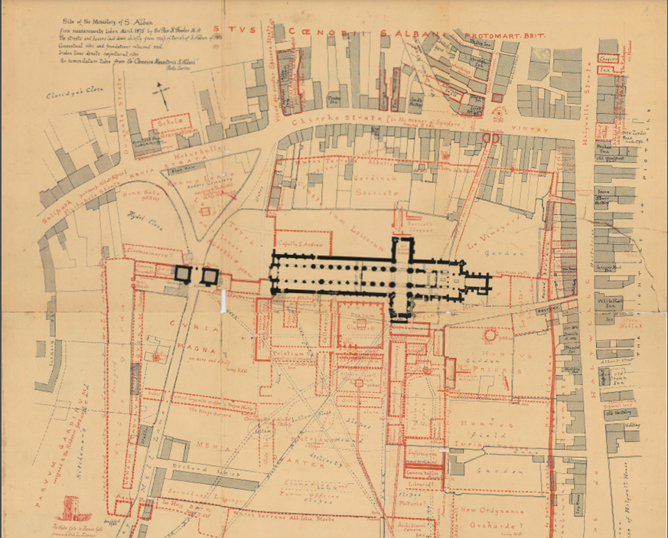

Slide 4
Notes:
Image copyright unknown. Every effort has been made to trace all image copyright holders and permissions in these resources, although occasionally it has not been possible to identify them. Please contact Maheema Chanrai at maheema.chanrai@history.org.uk with any queries.

Slide 5
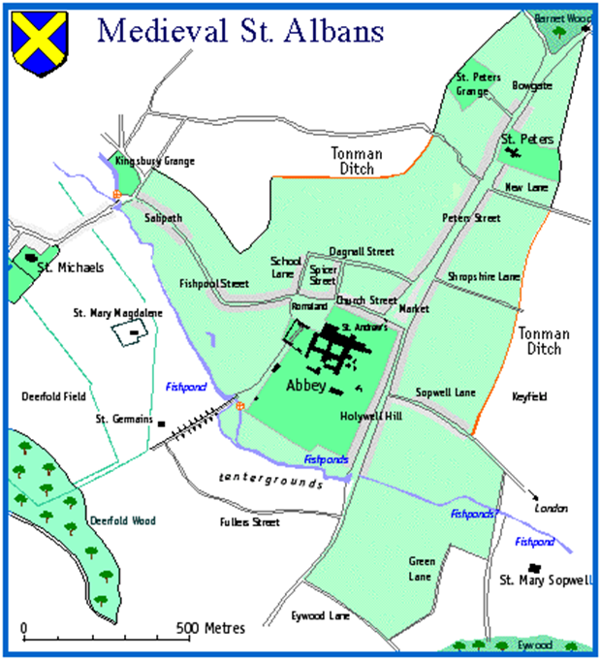
Notes:
Image: www.salbani.co.uk/Med%20Web/medtown.htm

